Slide 1
Eclipse Modelling Framework
S. de Lorenzo, E. Ebensperger,
P. Neulinger, M. Schrempf
and S. Vikoler

Slide 2
Table of Contents
Introduction
EMF, UML and Composite Pattern explenations
Framework
Generell and detailed description
EMF Demonstration and GUI Code Presentation
Example of Possibilities and GUI Demonstration

Slide 3
Assignment
Create a common framework for the simulation of almoust everything, e.g.: computer parts
This parts have a:
Name
Properties
Ports
Other parts as children
We used the composite pattern to realize the framework.

Slide 4
Assignment
Components and compositions of components, called composites, should be able to send data via connected I/O and hybrid ports to each other
A GUI controls the framework and sets its properties
We created a modiefed Composite-Pattern-UML-Diagram with the EMF to accomplish the task

Slide 5
Hypothesis
We are able to simulate a computer with different composites, which contain components
These composites are connected via ports to each other
A composite and a component can have n ports

Slide 6
Hypothesis
Ports can only have one other connected port
The three types of ports must be considered
Input
Output
Hybrid
Data is stored in the input and hybrid ports

Slide 7
Materials
Eclipse Modeling Framework
Books in Works Cited
Tutorials
Examples
Unified Modeling Language
Software Engineering Lecture
Book in Works Cited
Composite Pattern
Books in Works Cited

Slide 8
EMF – What is that?
Eclipse Modeling Framework (EMF) is an Eclipse-based modeling framework and code generation facility
You can build tools and other applications based on a structured data model
Models can be specified using annotated Java, UML, XML documents, or modeling tools, then imported into EMF
We used a UML-Diagram to draw the appendences from the interfaces and classes we created

Slide 9
EMF – Start problems
Compiliance level automatically turned down
Non generic Elists
Hand written code implementations of the body of a method
”Delete” deletes references from the diagram, not from the model
No java framework imports

Slide 10
EMF – Start problems
Only byte arrays
Only primitive data typs for global variables
Useless error messages
Interfaces cannot inherit from interfaces
Leads to useless code

Slide 11
EMF – Advantages
Easy:
UML diagrams
Installation
Code generation
Simple handling
Documentation
Editing
Insert own code in methods
You actually see the data structure

Slide 12
Unified Modeling Language
Unified Modeling Language (UML) is a standardized general-purpose modeling language in the field of object-oriented software engineering
The UML is used to specify, visualize, modify, construct and document the artifacts of an object-oriented software-intensive system under development
Standardized visual data structure representation

Slide 13
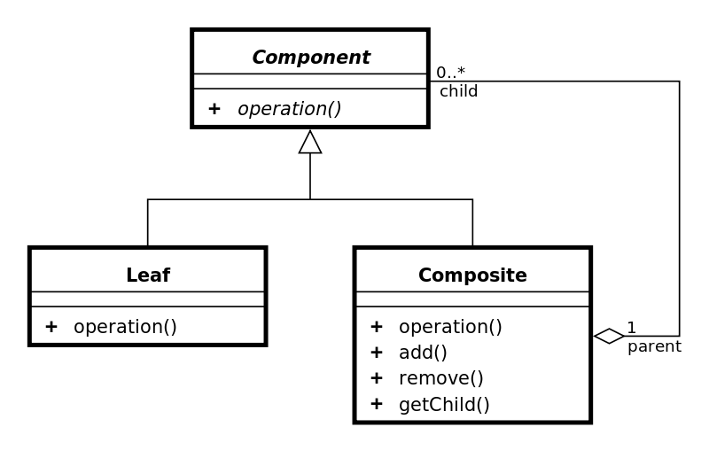
Composite Pattern

Slide 14
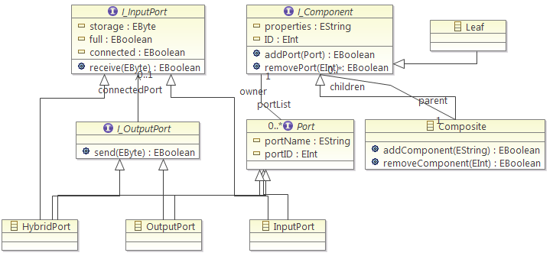
The Framework

Slide 15
I_Component
Properties, specified by the user
ID, Integer identification number of the component
addPort, Adds a Input-, Output- or Hybrid Port to the Component
removePort, Removes a Port from the component, specified by its ID

Slide 16
I_Component
The child contains the reference of its parent object. The object itself is called parent
EList<Port> portList 0:N, contains all ports of a composite

Slide 17
Composite
EList<Component> children 0:N, contains all children from this composite
AddComponent, adds a component as a new child in the EList
RemoveComponent, deletes a component, specified by an ID, from the EList
Inherits from I_Component

Slide 18
Leaf
Is a atomic component without children
Always the last element in a composite-component structure
Has no own attributes and methods
Is needed to know where an end is
Inherits from I_Component

Slide 19
I_Port
The generell interface for all ports
portName, Name of the Port
portID, Integer identification number of the Port
All ports inherit from this interface
In EMF an interface cannot inherit from an other interface!

Slide 20
I_InputPort
Interface for all ports which can recieve data:
Input
Hybrid
storage, To stores the received data
full, This is a flag its true if the input port is full, false if not
connected, is also a flag which decleares if a port is already connected or not
Receive, Receives data and stores it in the storage and considers the full flag

Slide 21
I_OutputPort
Interface for all ports which can send data
Output
Hybrid
Send, Uses an inputPort class object and calls its receive method

Slide 22
OutputPort
Sends data to an input port
Checks if the connected port is full, or not connected
Returns false if anything goes wrong
connectedPort 0:1, is the object which is connected

Slide 23
InputPort
Gets data from an output or hybrid port and stores it
For safety, it returns also false if the storage is already full or anything got wrong

Slide 24
HybridPort
Only port who inheritates from I_InputPort and I_OutputPort
Can perform all actions of an input and output port
connectedPort 0:1, is the object which is connected

Slide 25
EMF
Demonstration

Slide 26
GUI
Graphical user interface is a type of user interface that allows users to interact with electronic devices with images rather than text commands.
Programmed with Java Swing
Controls the components, you can do everything with the GUI:
Add/Delete Components
Add/Delete Ports
Add/Delete Connections
Send Data
Get an basic overview of the already existing data structure
Navigate through it

Slide 27
Changes
Added package: gui
Main
Controller
MainViewPanel
Added in package sp.impl, the class MainModel
API for GUI
Controls the other models
Model code is untouched

Slide 28
GUI
Demonstration

Slide 29
An Example
So after all, we know how our framework works.
To show, that it is a useful tool, we implemented an example to demonstrate how it works.
Therefore we decided to implement a production flow of the game, ANNO 2070, to demonstrate how much different working stations are required for a balanced production.

Slide 30
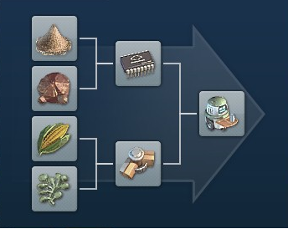
An Example

Slide 31
An Example
First we need sand and copper to construct electrical components.
From corn and alga we create biopolymer.
After that, we combine these two parts to construct little robots, which will help our habitants in all-day-situations.

Slide 32
Works Cited
Eclipse Modeling Framework, Second Edition
Dave Steinberg
Frank Budinsky
Marcelo Paternostro
Ed Merks
Software Engineering: Architektur-Design und Prozessorientierung
Wolfgang Pree
Gustav Pomberger
Wikipedia

Slide 33
Eclipse Modeling Framework
Thank‘s for your attention.

